Slide 1
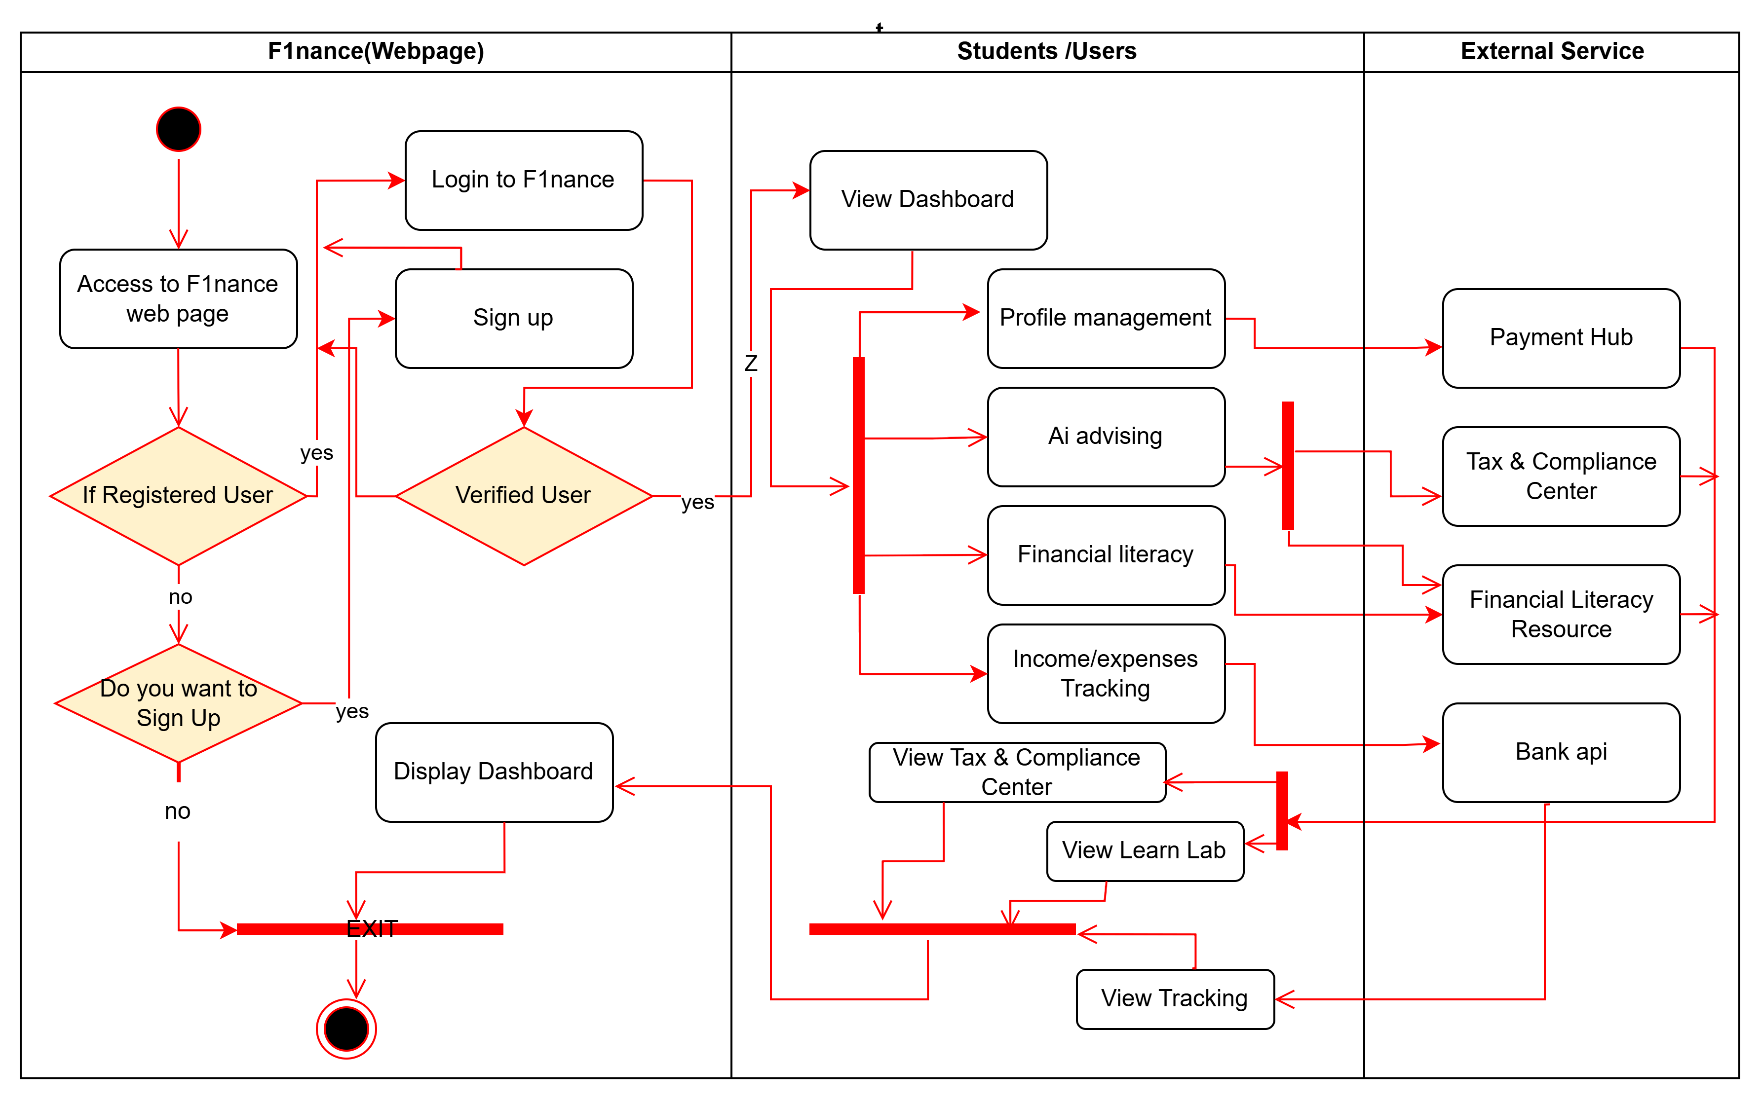
F1nance Activity Diagram

